Slide 1
Exception Handling

Slide 2
Exceptions
Introduction
Exception Types
Handling Exceptions
Try-catch
Try-with-Resources
Pass the Exception
Throwing Exception
Custom Exceptions

Slide 3
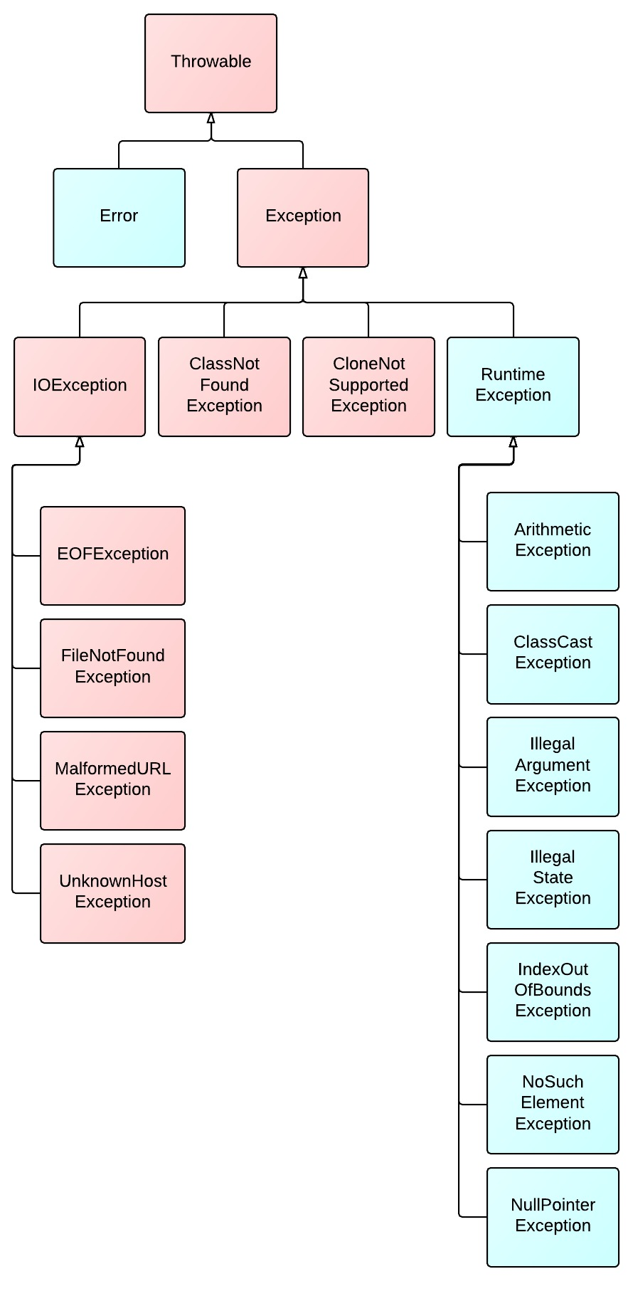
Exceptions
An exception is an instance of a class derived directly, or indirectly from the Trowable class.
pink: checked
blue: unchecked

Slide 4
Exception Types
Checked
Exceptions that need to be dealt with in the code
Includes all exceptions derived from the Exception class and are not derived from the RuntimeException class
Must be handled code or the code will not compile cleanly, resulting in compile-time errors.
Unchecked (Runtime exceptions)
Exceptions that do not need to be dealt with in the code
Includes all other exceptions (that are not checked)
Examples: division by zero, array subscripting errors
These do not have to be caught
Errors

Slide 5
Exception Handling Techniques
The try-catch block
The “try-with-resources” block
Pass the exception

Slide 6
The try-catch block
BufferedReader br = null;
try {
br = new BufferedReader(new FileReader("D:\\no-file.txt"));
} catch (FileNotFoundException e) {
e.printStackTrace();
}
java.io.FileNotFoundException: D:\no-file.txt (The system cannot find the file specified)
at java.io.FileInputStream.open(Native Method)
at java.io.FileInputStream.<init>(Unknown Source)
at java.io.FileInputStream.<init>(Unknown Source)
at java.io.FileReader.<init>(Unknown Source)
at exceptions.Example3.main(Example3.java:20)

Slide 7
Multiple catch blocks
Only the first catch statement that matches the exception will execute
If no matches are made, the method will terminate

Slide 8
Order of the catch blocks
When an exception is thrown, the exception object is compared to the catch blocks in the order that they are listed
Rule: always list the “most-derived” exceptions first

Slide 9
Multiple catch blocks
BufferedReader br = null;
try {
br = new BufferedReader(new FileReader("D:\\no-file.txt"));
String line = br.readLine();
int a = Integer.parseInt(line);
} catch (FileNotFoundException e) {
e.printStackTrace();
} catch (IOException e) {
e.printStackTrace();
} catch (NumberFormatException e) {
e.printStackTrace();
}

Slide 10
Multiple catch
BufferedReader br = null;
try {
br = new BufferedReader(new FileReader("D:\\no-file.txt"));
String line = br.readLine();
int a = Integer.parseInt(line);
} catch (IOException | NumberFormatException e) {
e.printStackTrace();
}
Why FileNotFoundException is not listed?

Slide 11
Why FileNotFoundException was not listed?
Exception
Runtime Exception
IOException
FileNotFoundException

Slide 12
Finally block
The finally block will execute either after the try block completes or after a catch block executes
The finally clause is guaranteed to run and generally contains “clean-up” code
However, finally block will not be executed if the System.exit method is invoked in a try or catch block.
Notes:
Cum nu se poate executa finally?

Slide 13
Finally block
BufferedReader br = null;
try {
br = new BufferedReader(new FileReader("D:\\no-file.txt"));
} catch (FileNotFoundException e) {
e.printStackTrace();
} finally {
// perform any necessary clean-up action
}

Slide 14
Nested try-catch
BufferedReader br = null;
try {
br = new BufferedReader(new FileReader("D:\\no-file.txt"));
} catch (FileNotFoundException e) {
e.printStackTrace();
} finally {
try {
br.close();
} catch (IOException e) {
e.printStackTrace();
}
}

Slide 15
Try-with-resources
Introduced in Java 7
All resources opened with the block are automatically closed upon exit from the block
Resources are declared and initialized inside a set of parentheses, and are placed between the try keyword and the opening curly brace of the try block
Resources declared with a try-with-resources block must be separated by semicolons

Slide 16
Try-with-resources
try (BufferedReader br = Files.newBufferedReader(Paths.get(new URI("D:\\no-file.txt")));
BufferedWriter wr = Files.newBufferedWriter(Paths.get(new URI("D:\\filename.txt")))) {
// code here
} catch (IOException | URISyntaxException e) {
e.printStackTrace();
}

Slide 17
Pass the exception
public static void main(String[] args) {
try {
openFile();
} catch (FileNotFoundException e) {
e.printStackTrace();
}
}
public static void openFile() throws FileNotFoundException {
BufferedReader br = null;
br = new BufferedReader(new FileReader("D:\\no-file.txt"));
}
Notes:
throws vs throw ????

Slide 18
Throwing Exceptions
public static void main(String[] args) {
if (args.length == 0) {
System.out.println("Error: No argument");
System.exit(-1);
} else {
// do your job here
}
}
public static void main(String[] args) {
if (args.length == 0) {
throw new IllegalArgumentException("No argument");
} else {
// do your job here
}
}

Slide 19
Custom Exceptions
public class MyCustomException extends Exception {
private String message;
public MyCustomException(){
super();
}
public MyCustomException(String message) {
super(message);
this.message = message;
}
@Override
public String getMessage() {
return message;
}
}
public class MyCustomExceptionTest {
public static void main(String[] args) {
try {
aMethod();
} catch (MyCustomException e) {
e.printStackTrace();
}
}
public static void aMethod() throws MyCustomException {
throw new MyCustomException("this is a custom exception");
}
}
exceptions.MyCustomException: this is a custom exception
at exceptions.MyCustomExceptionTest.aMethod(MyCustomExceptionTest.java:14)
at exceptions.MyCustomExceptionTest.main(MyCustomExceptionTest.java:7)

Slide 20
Questions?

Slide 21


Thank you! ☺
Elena Pistol
Developer
elena.pistol@endava.com
en_epistol

